Slide 1





Kyle Stanford
Data Analyst

Slide 2













Here are some of the projects I have worked on:
These are the tools I have used:
GameCo
Gaming Company
Influenza Forecasting
Public Health Sector – U.S.
Excel
PowerPoint
Tableau
Rockbuster Stealth
Video Rental Company
Instacart Basket Analysis
Online Grocery Shop
SQL
PostgreSQL
GitHub
Pig E. Bank
Finance Industry
Lung Cancer Survival
Public Health Sector - EU
Python
Juptyer

Slide 3
Tools
Used
GameCo
Gaming Company
Context
GameCo is a new video game company with markets across the globe. They want to understand market trends to inform the development and marketing of new games.
Data (click here for raw data)
Historical sales data of video games that have sold over 10,000 copies between 1980 and 2020 – from VGChartz
Technical Skills
Data Cleaning
Pivot Tables
Data Grouping and Summarising
Descriptive Analysis
Visualisations in Excel & PowerPoint
Storytelling with Data
Goal
Analyse regional sales trends to support GameCo in making data-driven decisions.

Slide 4

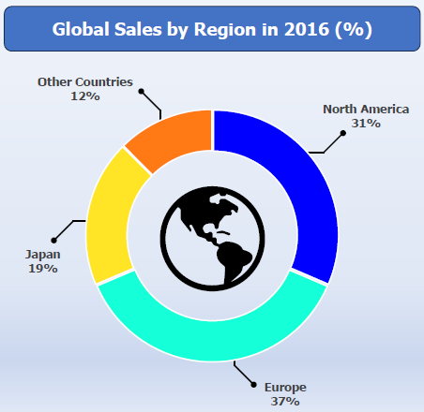
Approach and Process
Data Preparation
Conducted an exploratory analysis to find and address inconsistencies, duplicates, and missing values.
Data Analysis
Utilised pivot tables to group and summarise data by region, genre, and publisher. Filtered data to focus on the last 10 years of consistent data.
Visualisation and Presentation
Created doughnut charts, line charts, and 100% stacked column charts to visualise market trends.
Doughnut chart showing distribution of video game sales in 2016

Slide 5

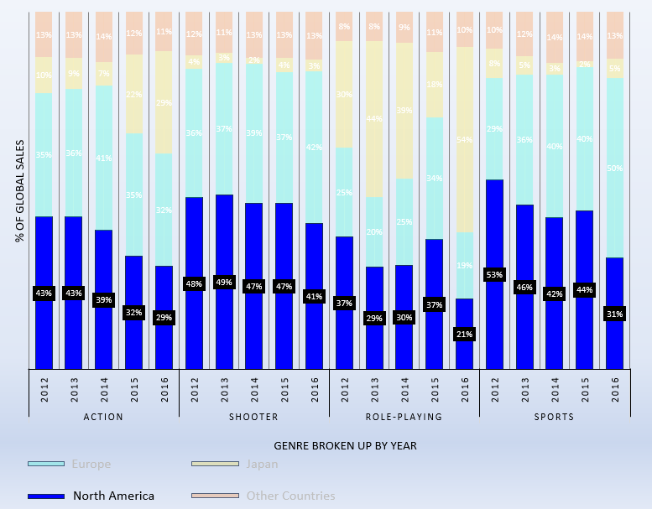
Challenges and Solutions
Complex Analysis
Used pivot tables and calculated fields to answer business questions requiring complex data groupings.
Translating Data to Insights
Utilised advanced formatting options in MS PPT to construct clear data visualisations and communicate findings to stakeholders.
100% Stacked Column Chart showing global sales distribution by genre from 2012 to 2016. Formatted to focus on downward trend in North American market across all genres.

Slide 6

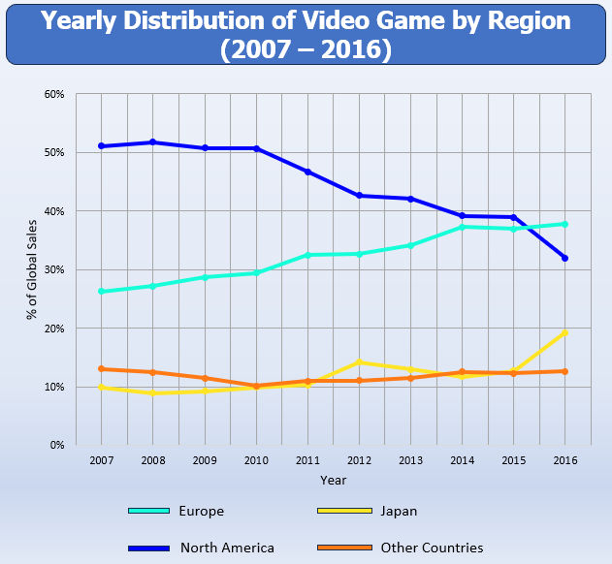
Results and Deliverables
Main Findings
Europe’s market share overall raised steadily but was most notable in the “shooter” and “sport” genres.
Increased sales of “role-playing” games contributed to a successful year in 2016 in Japan.
Sales in North America have continued to decline. This was consistent in all genres.
Deliverables
Excel Report: containing cleaned data, pivot tables, and charts.
Final Presentation: summarising key findings and recommendations to GameCo.
Project Reflections Document: outlining analytical processes which lead to each insight.
This line chart shows general shifts in market dynamics between North America, Europe, Japan, and other countries over the last decade’s worth of full data

Slide 7
Tools
Used
Influenza Forecasting
Public Health Sector – U.S.
Context
A medical staffing agency, responsible for providing temporary workers to hospitals on an as-needed basis, requires assistance in planning for influenza season.
Data
Influenza Deaths by Geography (Source – CDC)
U.S. Census Data (Source – US Census Bureau)
Technical Skills
Data cleaning, integration, and transformation
Statistical hypothesis testing
Visual analysis
Forecasting in Tableau
Storyboards in Tableau
Presenting results
Goal
Analyse influenza trends focusing on vulnerable populations, especially those over 65-years-old, to proactively plan for staffing needs across the country.

Slide 8




Approach and Process
Data Analysis
Hypothesis Testing – determined if the mortality rate for older individuals (65+) was higher than other ages.
Visual analysis – used Tableau Public to identify influenza seasonality and distributions of vulnerable populations across the United States.
Data Preparation
Cleansed both datasets of inconsistencies, duplicate values, and addressed missing values.
Integrated datasets by using VLOOKUP.
Grouped age ranges and normalised influenza mortality rates for data analysis.
Visualisations and Presentation
Created various charts including combination maps in Tableau Public to show findings.
Presented Tableau Storyboard along with recommendations to stakeholders.

Slide 9

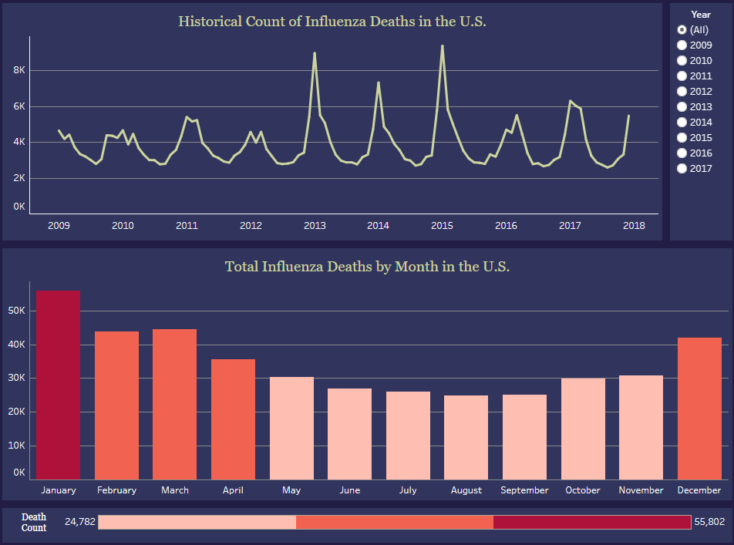
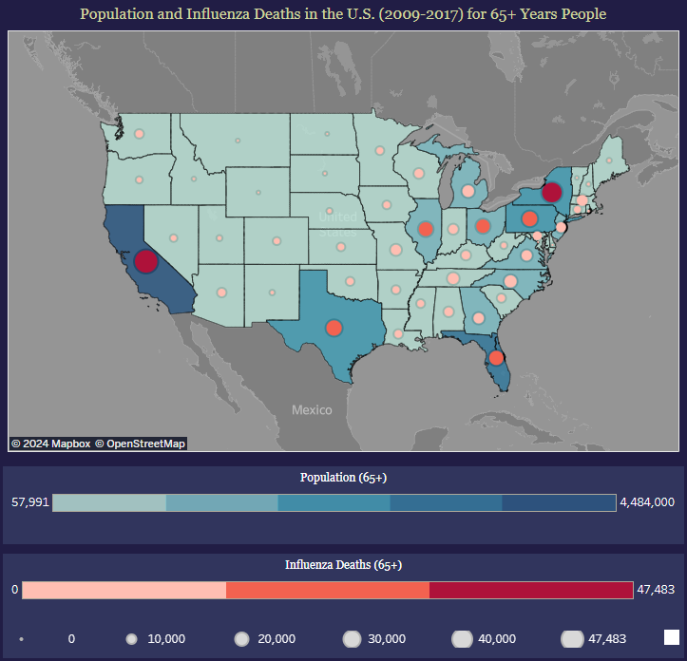
Challenges and Solutions
Interactive Data Presentation
To highlight shifts and consistencies of influenza seasonality over many years, interactive filters were added to the Tableau Storyboard.
Multivariable Spatial Analysis
To compare each states’ total vulnerable population to their vulnerable population mortality count, combination maps in Tableau were utilised.
Graphs illustrating influenza seasonality with Year filter
Combination map showing distribution of older citizen population (blue) and older citizen influenza deaths (red)

Slide 10

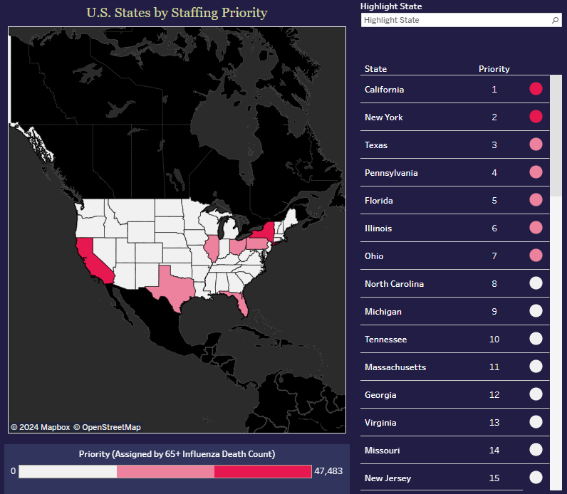
Results and Deliverables
Results
Categorised states by urgency of staffing needs.
Identified peak staffing needs will occur from December to March (influenza season).
Recommendation for further analysis regarding hospital and clinic staff-patient ratios.
Deliverables
Interim Report: project progress and findings, including data limitations, descriptive and statistical analysis, and next steps.
Tableau Storyboard: interactive storyboard containing visualisations and recommendations.
Link to Tableau storyboard
Video Presentation: Screencast walkthrough of storyboard with explanations of project analysis and insights.
Link to video presentation
Choropleth map showing states by staffing priority, accompanied with a scrollable list and priority rankings for clarity. A highlight field has also been added for ease of use.

Slide 11
Tools
Used
Rockbuster Stealth
Video Rental Company
Context
Rockbuster Stealth LLC is a movie rental business with stores around the world. It’s trying to compete with popular streaming services by launching an online video rental service.
Data (click here for zip folder)
Rockbuster Relational Database containing 15 connected tables.
Technical Skills
Database querying:
Filtering
Joins
Common Table Expressions
Database cleaning
Data profiling and creating a Data Dictionary
Data visualisation in Tableau Public
.
Database querying:
Summarising
Subqueries
Goal
Assist Rockbuster in launching their online video rental service by using SQL to analyse Rockbuster’s data and answer ad-hoc business questions.

Slide 12





Approach and Process
Visualisations and Presentation
Developed Tableau dashboards to visualise insights from SQL queries.
Created a PowerPoint presentation with business recommendations for stakeholders.
Data Preparation
Consistency checks made to ensure no duplicates, no missing values, and uniformity across multiple tables.
Data Understanding
Data dictionary and entity relationship diagram created to best understand Rockbuster’s database.
Data Analysis
Various SQL queries made to answer simple and complex business questions, e.g., “Which movies contributed most/least to revenue gain”?

Slide 13

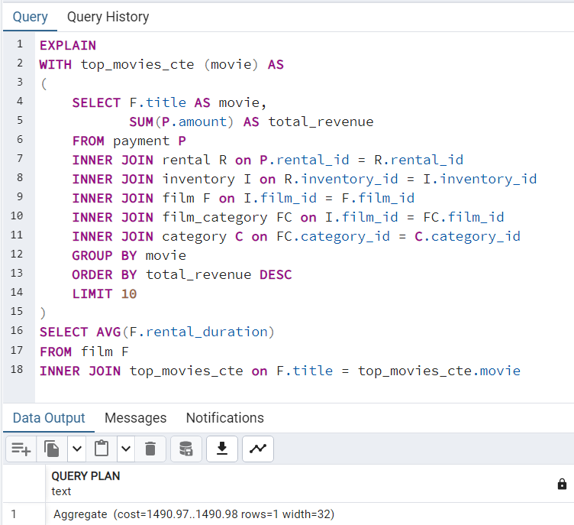
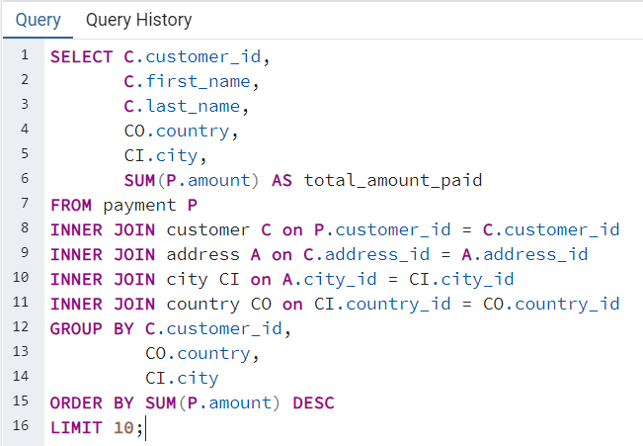
Challenges and Solutions
Complex Queries Across Tables
Data required to answer business questions often existed across multiple tables within the database. JOINS, GROUP BY, LIMIT, and other clauses used to query this data.
Query Optimization
Optimized SQL queries for efficiency and accuracy. This was done by using the EXPLAIN clause to evaluate query costs.
SQL query designed to answer the question “Where are customers with a high lifetime value based”. Result returns top 10 customers based on lifetime spending along with their country and city of residence.
EXPLAIN query that returns the cost of a query that finds the average rental duration of Rockbuster’s top 10 movies.

Slide 14

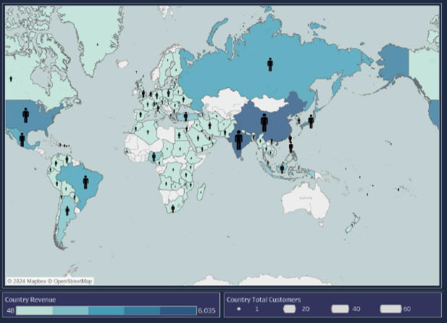
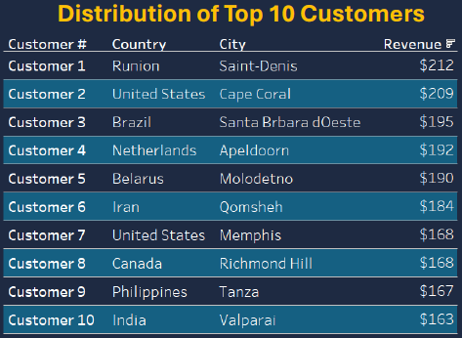
Results and Deliverables
GitHub Project Repository Link
Chart showing revenue and total customers in each country
Table showing top 10 customers and their locations determined by total revenue.
Results
Identified Rockbuster’s top and bottom performing movies by revenue (including unrented movies)
Mapped global customer and revenue distribution.
Determined high-value customers don’t necessarily reside in countries with the most customers.
Deliverables
Data Dictionary: comprehensive document detailing the structure and relationship of Rockbuster’s database.
SQL Queries File: Excel file storing SQL queries and their outputs.
Final Presentation: PowerPoint summarizing key findings and recommendations for Rockbuster.
Tableau Dashboards: visualisations used in presentation.
Link to Tableau Dashboards

Slide 15
Tools
Used
Instacart Basket Analysis
Online Grocery Shop
Context
Instacart is an online grocery store operating through an app. They want to target different customers with applicable marketing campaigns.
Data
Instacart’s customer data, product data, and orders data.
The final dataset contained 32,399,732 rows
(Instacart is a real company, but the data used was fabricated by CareerFoundry for this project)
Technical Skills
Python:
Data cleaning
Wrangling and merging
Deriving variables
Population flows
Reporting in Excel
Technical Skills
Aggregations
Data visualisation
Goal
Perform an initial data and exploratory analysis of Instacart’s data to derive insights for better customer segmentation based on provided criteria.

Slide 16




Approach and Process
Data Analysis
Conducted descriptive statistics with NumPy and Pandas.
Segmented customers based on purchasing habits and demographic information.
Constructed visualisations using Matplotlib and Seaborn to answer business questions.
Data Preparation
Loaded and cleaned datasets using Pandas.
Merged datasets to make a comprehensive dataframe.
Reporting
Population flow refined.
Data processes documented.
Visualisations selected and recommendations made.

Slide 17

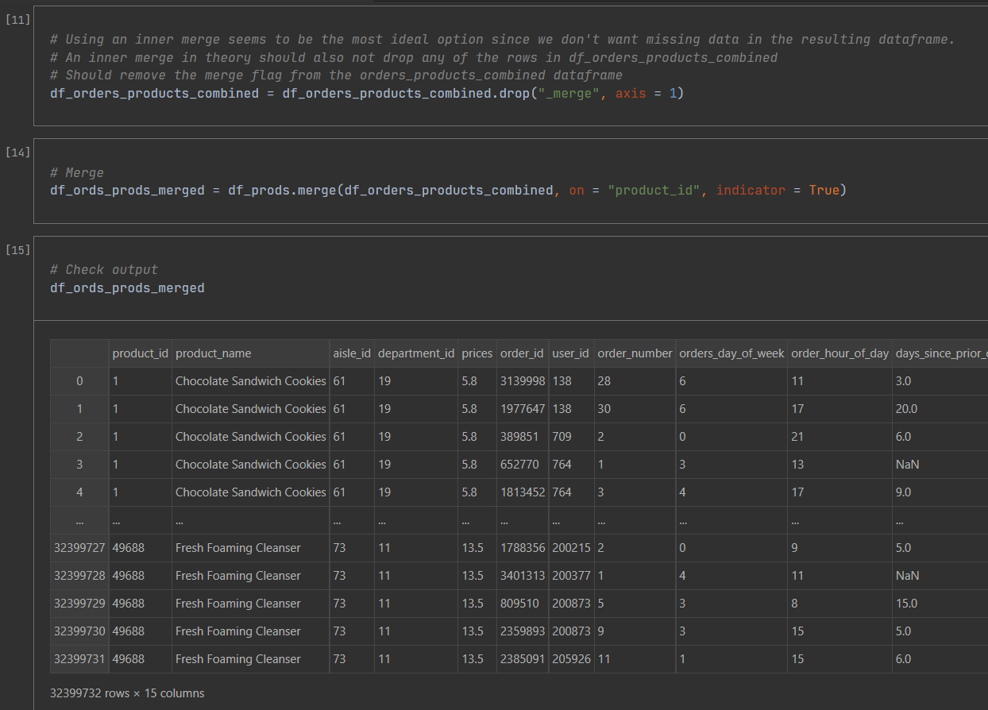
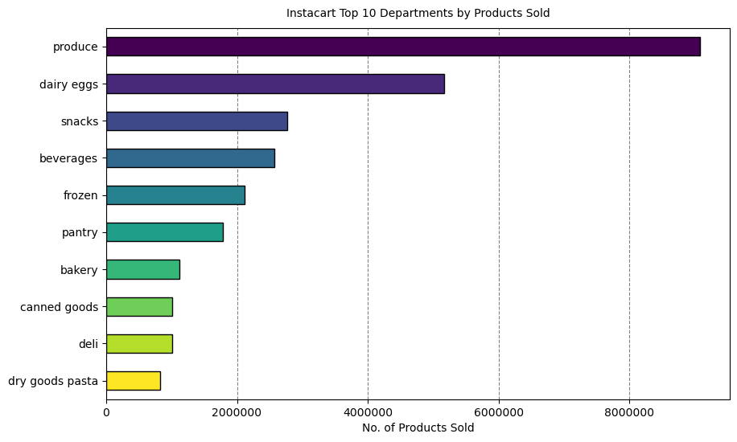
Challenges and Solutions
Data Integration
Managed the integration of multiple datasets ensuring data integrity and consistency.
Complex Visualisation Coding
Created concise and impactful visualisations by leveraging ChatGPT to edit my previous code.
Horizontal bar chart showing Instacart’s top 10 departments based on total product sales. ChatGPT was used to modify some visual aesthetics and limit the visualisation to only the top 10 departments.
Code snippet showing inner merge of 2 datasets with checks and comments.

Slide 18

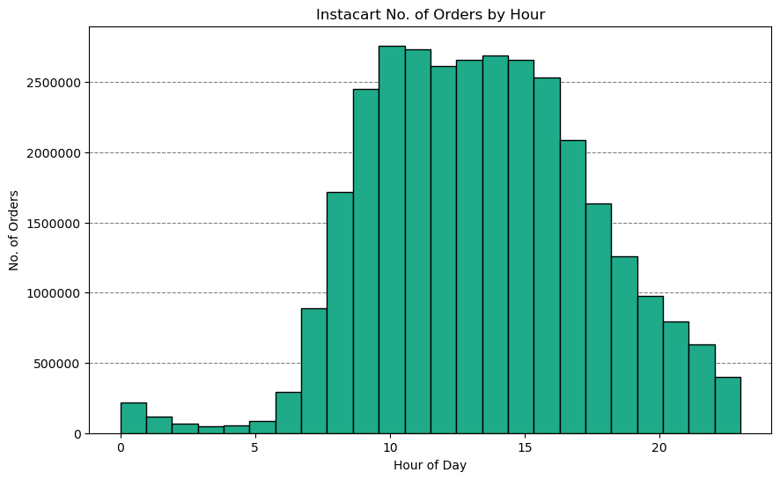
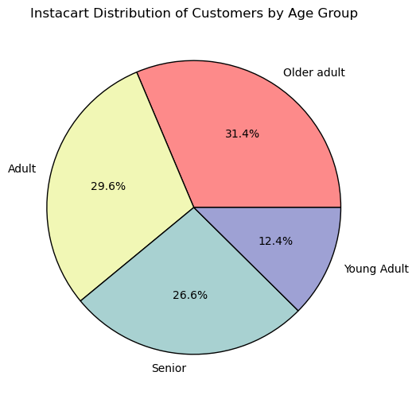
Results and Deliverables
GitHub Project Repository Link
Histogram showing the number of products ordered across each hour of the day (24 bins used)
Pie Chart showing the distribution of customers based on assigned age groupings.
Results
Identified peak operational hours and days of the week to optimize ad scheduling.
Segmented customers based on loyalty, region, age, and family status to help direct marketing efforts.
Identified most of Instacart’s customer base consists of new customers, who may be enticed to return with loyalty programs.
Deliverables
Jupyter Notebooks: All python code used throughout project, documenting data cleaning, analysis, and visualisations.
Excel Report: File containing population flow, data cleaning and wrangling steps, key findings, Python visualisations, and recommendations for Instacart.

Slide 19
Tools
Used
Pig E. Bank
Finance Industry
Context
Pig E. Bank is a European financial institution which is seeking to understand factors contributing to customer attrition.
Data
Pig E. Bank customer data
Includes account information, demographic data, and other variables.
Technical Skills
Data Mining
Data Preparation
Analysis (Pivot Tables)
Classification Modelling (Decision Trees)
Understanding of Data Ethics
Goal
Identify key factors influencing customer churn and develop a model to assess the likelihood a customer will leave Pig E. Bank.

Slide 20




Approach and Process
Data Analysis
Created pivot tables for all tables.
Compiled pivot tables into large comparison table.
Identified and recorded variables associated with high customer attrition.
Data Preparation
Cleansed data from missing values and inconsistent formatting.
Removed Personally Identifiable Information.
Separated data into “exited customers” table and “current customers” table.
Modelling
Selected and ranked top 4 variables associated with customer attrition.
Created decision tree based on these variables.

Slide 21

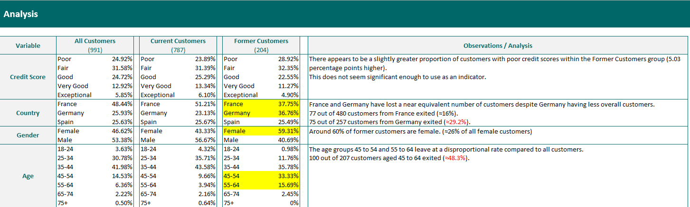
Challenges and Solutions
Deciding Variable Importance for the Model
Variables were considered and ranked for implementation in the decision tree model based on relative attrition rates and overall customers left.
This ensured the model would not unfairly favour categories with more total customers (such as binary categories like gender) over more segmented categories with higher attrition rates (such as age groupings).
Analysis containing multiple pivot table results – variables of interest highlighted, and relative attrition rates calculated (in red)

Slide 22

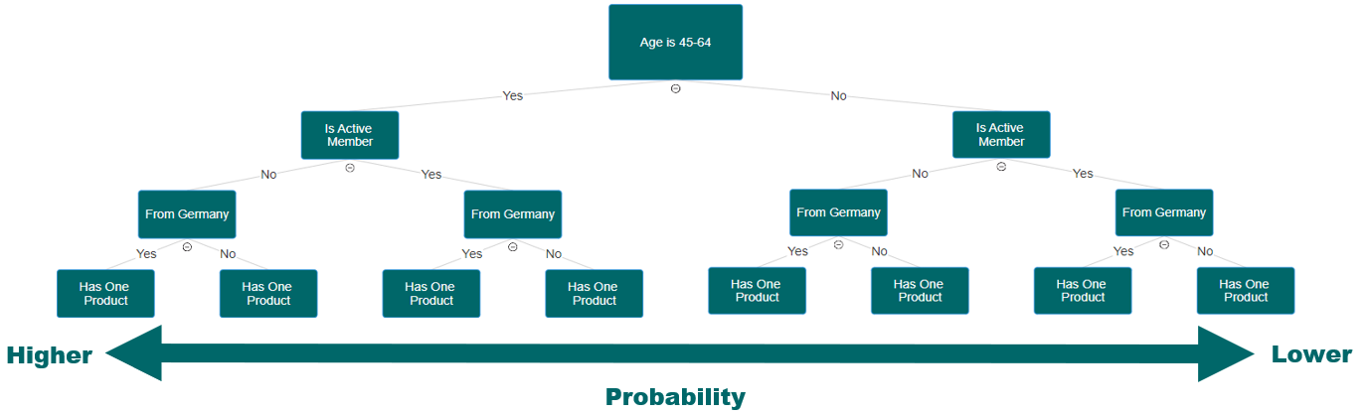
Results and Deliverables
Decision Tree model created to determine the risk that a customer will exit the bank.
Results
Identified top risk factors that a customer will exit the bank
Produced decision tree model
Deliverables
Excel Report: Comprehensive Excel report containing raw data, data cleaning practices, pivot tables, descriptive statistics, analysis and model.

Slide 23
Tools
Used
Lung Cancer Survival
Public Health Sector - EU
Context
Lung cancer is the leading cause of cancer death in men and second in women. Predictive models can help determine patient chance of survival.
Data
Lung Cancer Mortality Dataset – Kaggle
Custom shapefile containing EU countries – Vector Maps
Country Development Indicators – World Bank
Technical Skills
Sourcing Open Data
Correlation Heatmaps and Scatterplots
Geospatial Analysis with JSON files
Linear Regression Analysis in Python
Cluster Analysis (k-means)
Tableau Dashboard Creation
Goal
Analyse health indicators, demographic data, and treatment-related variables of lung cancer patients to determine which factors increase survival rates.

Slide 24

Guiding Questions
Who is this for?
This project could be utilised by public health and research agencies across EU countries.
What will it consist of?
The project will start with the aim to analyse patient survival rates based on demographic factors, health indicators, and treatment received. This may shift pending the results of the various analyses.
Why is it being built?
The project is being built to explore factors that may be used to assess lung cancer patients’ chance of survival. It may also serve as a jumping-off point for further research pending its results.
When will it be used?
In theory, the results of the project could be used when planning further research into lung cancer mortality. The results may highlight areas worth further exploration.
Where will it be hosted?
The project will be hosted as a storyboard on Tableau Public

Slide 25




Approach and Process
2. Exploratory Data Analysis
Created correlation heatmap, histograms, and pair plots using SciPy and Matplotlib.
Liaised with supervisor/mentor about potential issues within the data.
Focused efforts on weakly correlated treatment-specific variables.
1. Data Sourcing & Preparation
Sourced main dataset from Kaggle.
Checked and addressed missing values, duplicates and outliers.
Sourced supplementary data on EU countries from World Bank and reformatted in Excel.
Merged World Bank data with main dataset.
3. Linear Regression
Conducted a linear regression in Python using Scikit-Learn library.
As the model explained less than 1% (r-squared < 0.01) of the variance in the data, a linear model was deemed unsuitable.

Slide 26



Approach and Process
5. Geospatial Analysis
Conducted geospatial analysis with custom shapefile of EU countries.
Used Folium library in Python to analyse lung cancer distribution, survival rates, and treatment types by country.
4. Cluster Analysis
Used the k-means algorithm to find clusters in the data with the aim to find unexpected patterns.
This resulted in patients being grouped in two clusters determined mostly by the only two strongly correlated variables in the data.
Adding more clusters was trialled unsuccessfully.
6. Further Analysis & Presentation
Further explored relationships between survival rates and health indicators and smoking status.
Delved further into linear regression by subdividing data by cancer stage and treatment received.
Document and presented all analyses in Tableau Storyboard.

Slide 27

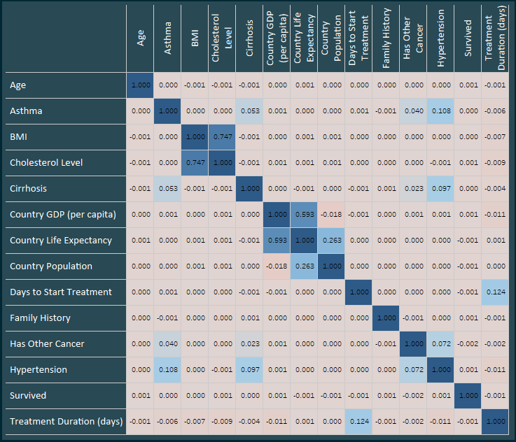
Challenges and Solutions
Working with Poorly Correlated Variables
A correlation heatmap showed that patient survival was poorly correlated with all other variable. After liaising with a mentor, it was decided that:
Proceeding analyses could focus on relationships between treatment related variables.
Data would be wrangled in later steps to obtain and compare survival rates.
Correlation heatmap showing “survived” column having no correlation with other variables

Slide 28
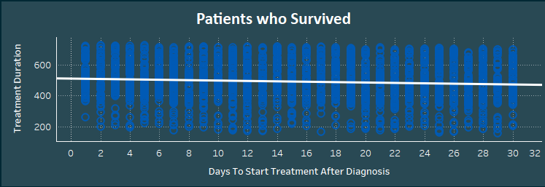
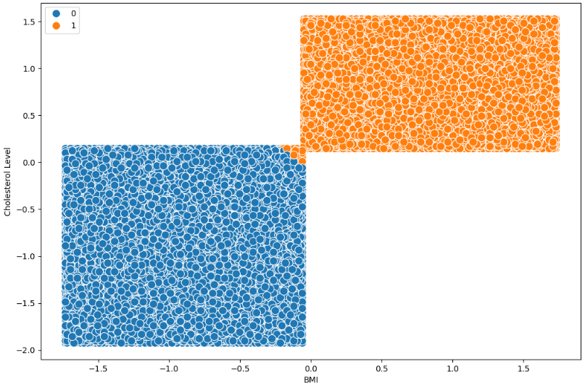
Challenges and Solutions
Analyses Yielding Insignificant Result
Linear Regression Analysis:
More than 99% of the data’s variance could not be explained by the model.
Data was subdivided based on categorical variables aiming to reduce the variance and yield new insights.
Cluster Analysis:
Clusters determined by algorithm were heavily determined by only two variables. Analysis on scatterplots yielded insignificant results.
Additional clusters were added to the algorithm but still yielded insignificant results.
Overall, these approaches were considered unsuitable and alternative analyses were conducted to further the project.
Linear regression on only patients who survived treatment with additional filters (treatment, cancer stage, and smoking status)
Scatterplot showing how clusters were mostly determined by the relationship between patients’ BMI and cholesterol levels.

Slide 29

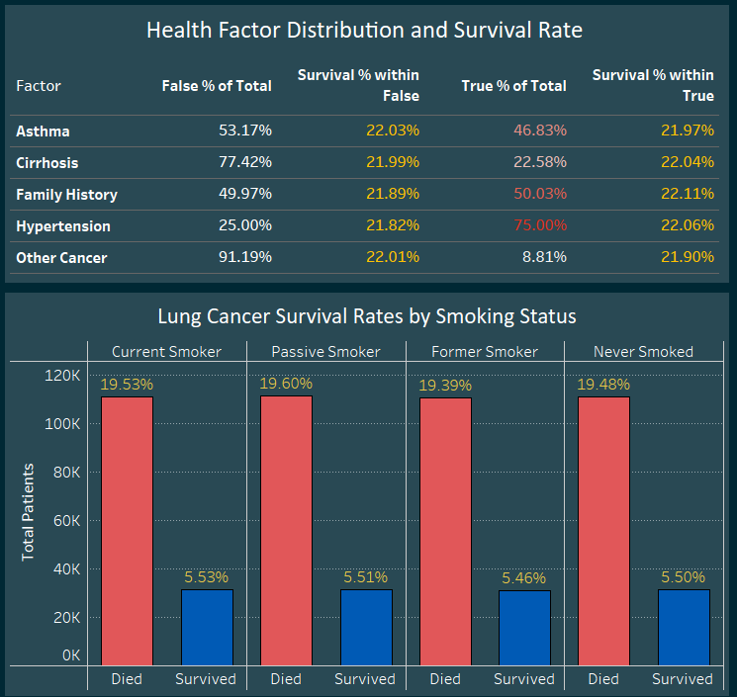
Results and Deliverables
GitHub Project Repository Link
Key Findings
Lung cancer survival did not appear affected by any health indicator, treatment received, or demographic factors.
By cross checking data with Eurostat publications, lung cancer does seem more prevalent in people with hypertension and asthma.
Survival rates did not vary significantly across countries in the EU.
Project Limitations:
The dataset is artificially generated, meaning it may not capture full variability and complexity of real-world data.
If the data is not based on accurate distribution or contains inherent biases, results may be misleading.
Models trained on this data have limited transferability to real-world applications.
Deliverables:
Jupyter Notebooks: All python code used throughout project, documenting data cleaning and all analyses.
Tableau Storyboard: Presentation of project analyses, results, limitations, and next steps.
Snippet of Tableau Dashboard analysing distributions and survival rates of patients amongst groups based on health indicators.
(Link to Tableau Storyboard)

Slide 30
Thank you!
Kyle Stanford
Let’s connect:

